Slide 1

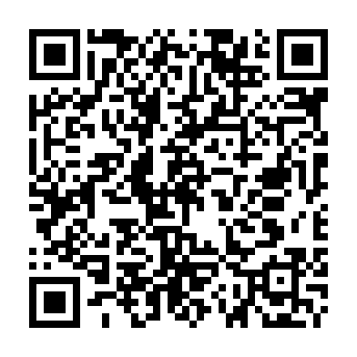

An idea of Leonardo Chistè, Rayan Alessandro Tekaia, Alberto Battistini and Saksham Bakshi
Want to see the full project? Visit the following website or scan the QR Code!
https://github.com/PossumLiarR/Smart-Surveillance

Slide 2
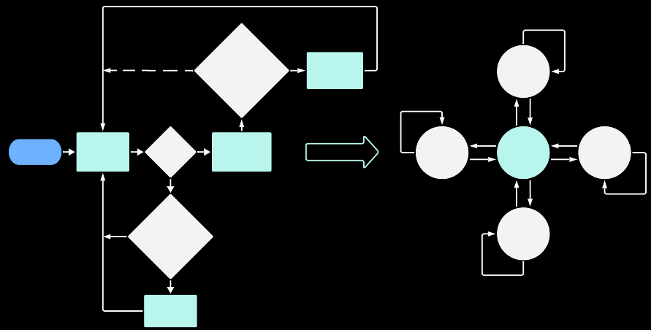
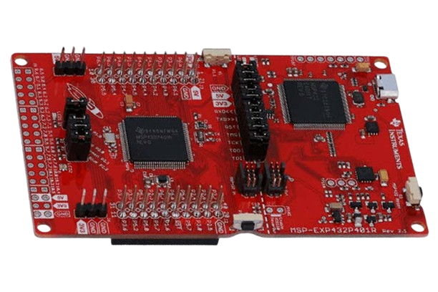
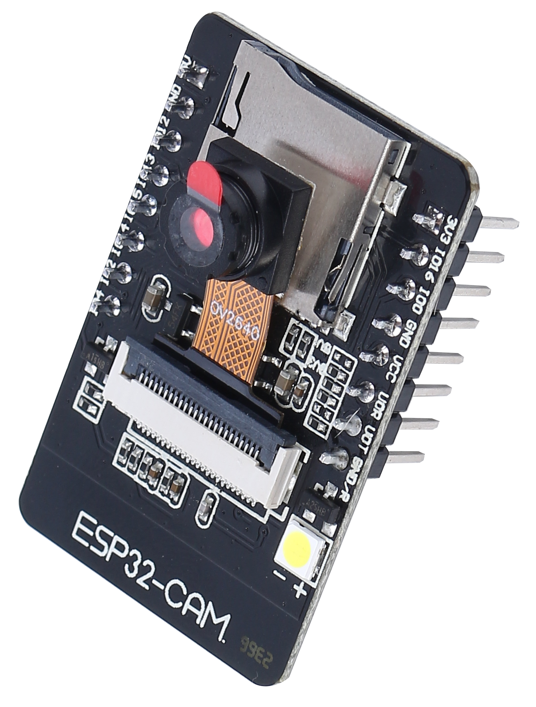


Smart Surveillance: Software Architecture
No
image_counter_to_send >= SEND_IMAGE_MAX
?
Yes
Send image to Telegram Bot
UP
TI MSP432
ESP32 CAM
U
D,C
Yes
Send direction to MSP432
L
L,C
Start
Motion Detection
Motion detected
?
UART
LEFT
CENTER
RIGHT
R,C
R
L – R – U – D – C
No
U,C
D
No
frames_without_motion >= MOTION_LIMIT?
DOWN
SERVO 2 = Y-AXIS (UP – DOWN)
Yes
Reset servo configuration
SERVO 1 = X-AXIS (LEFT – RIGHT)

Slide 3
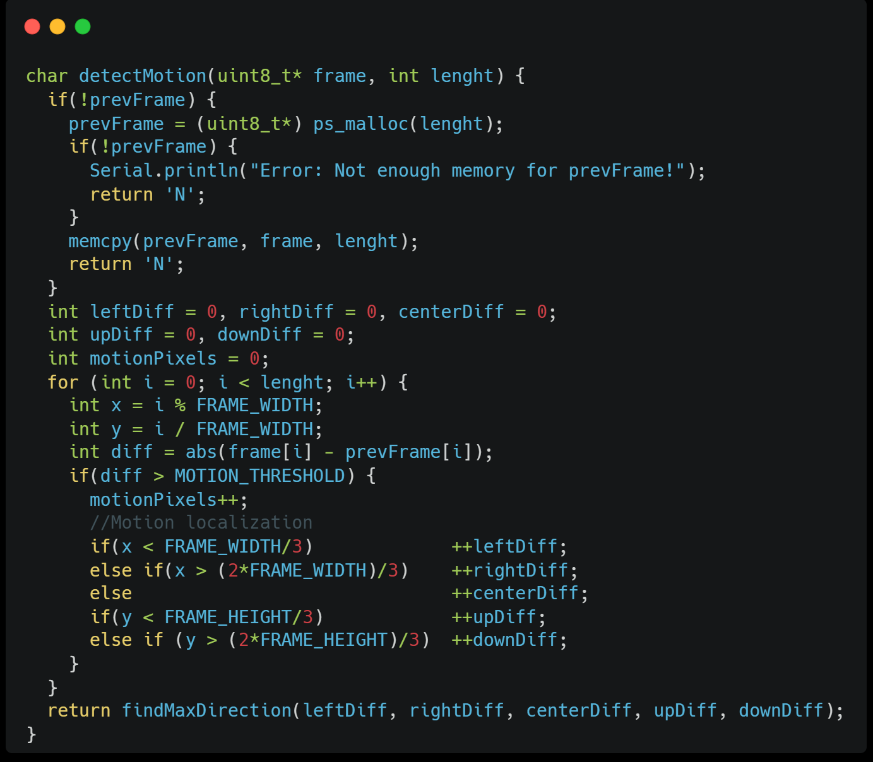
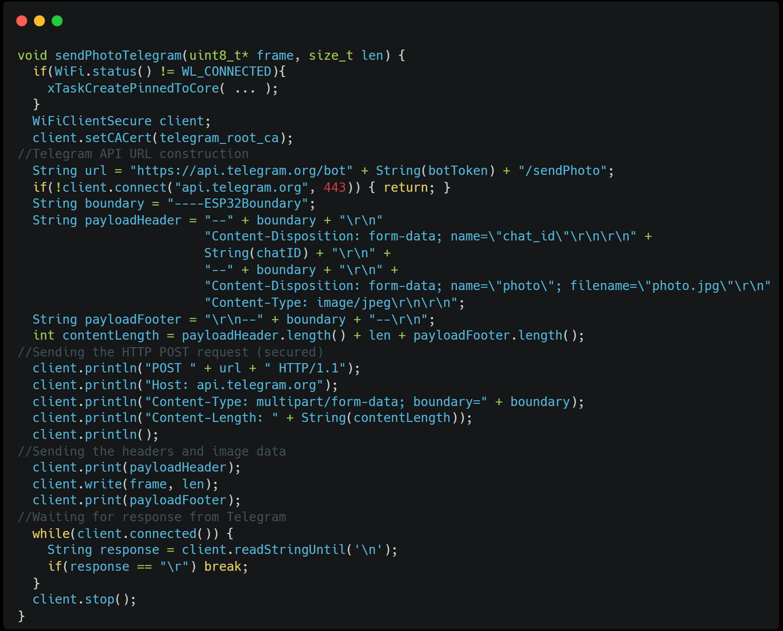
Smart Surveillance: Representative code blocks
MOTION DETECTION
SEND PHOTO TO TELEGRAM BOT

Slide 4
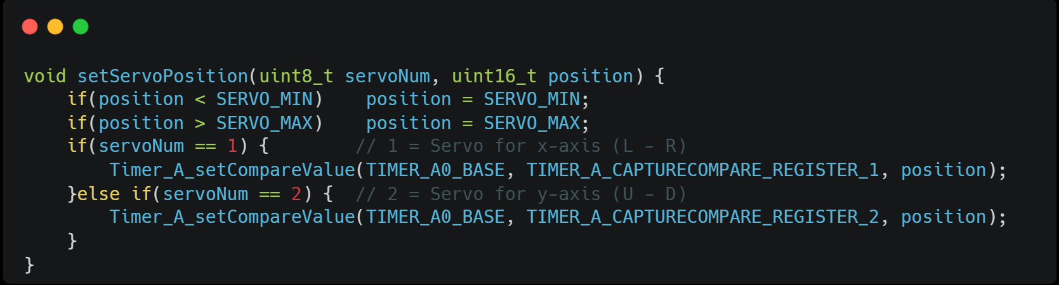
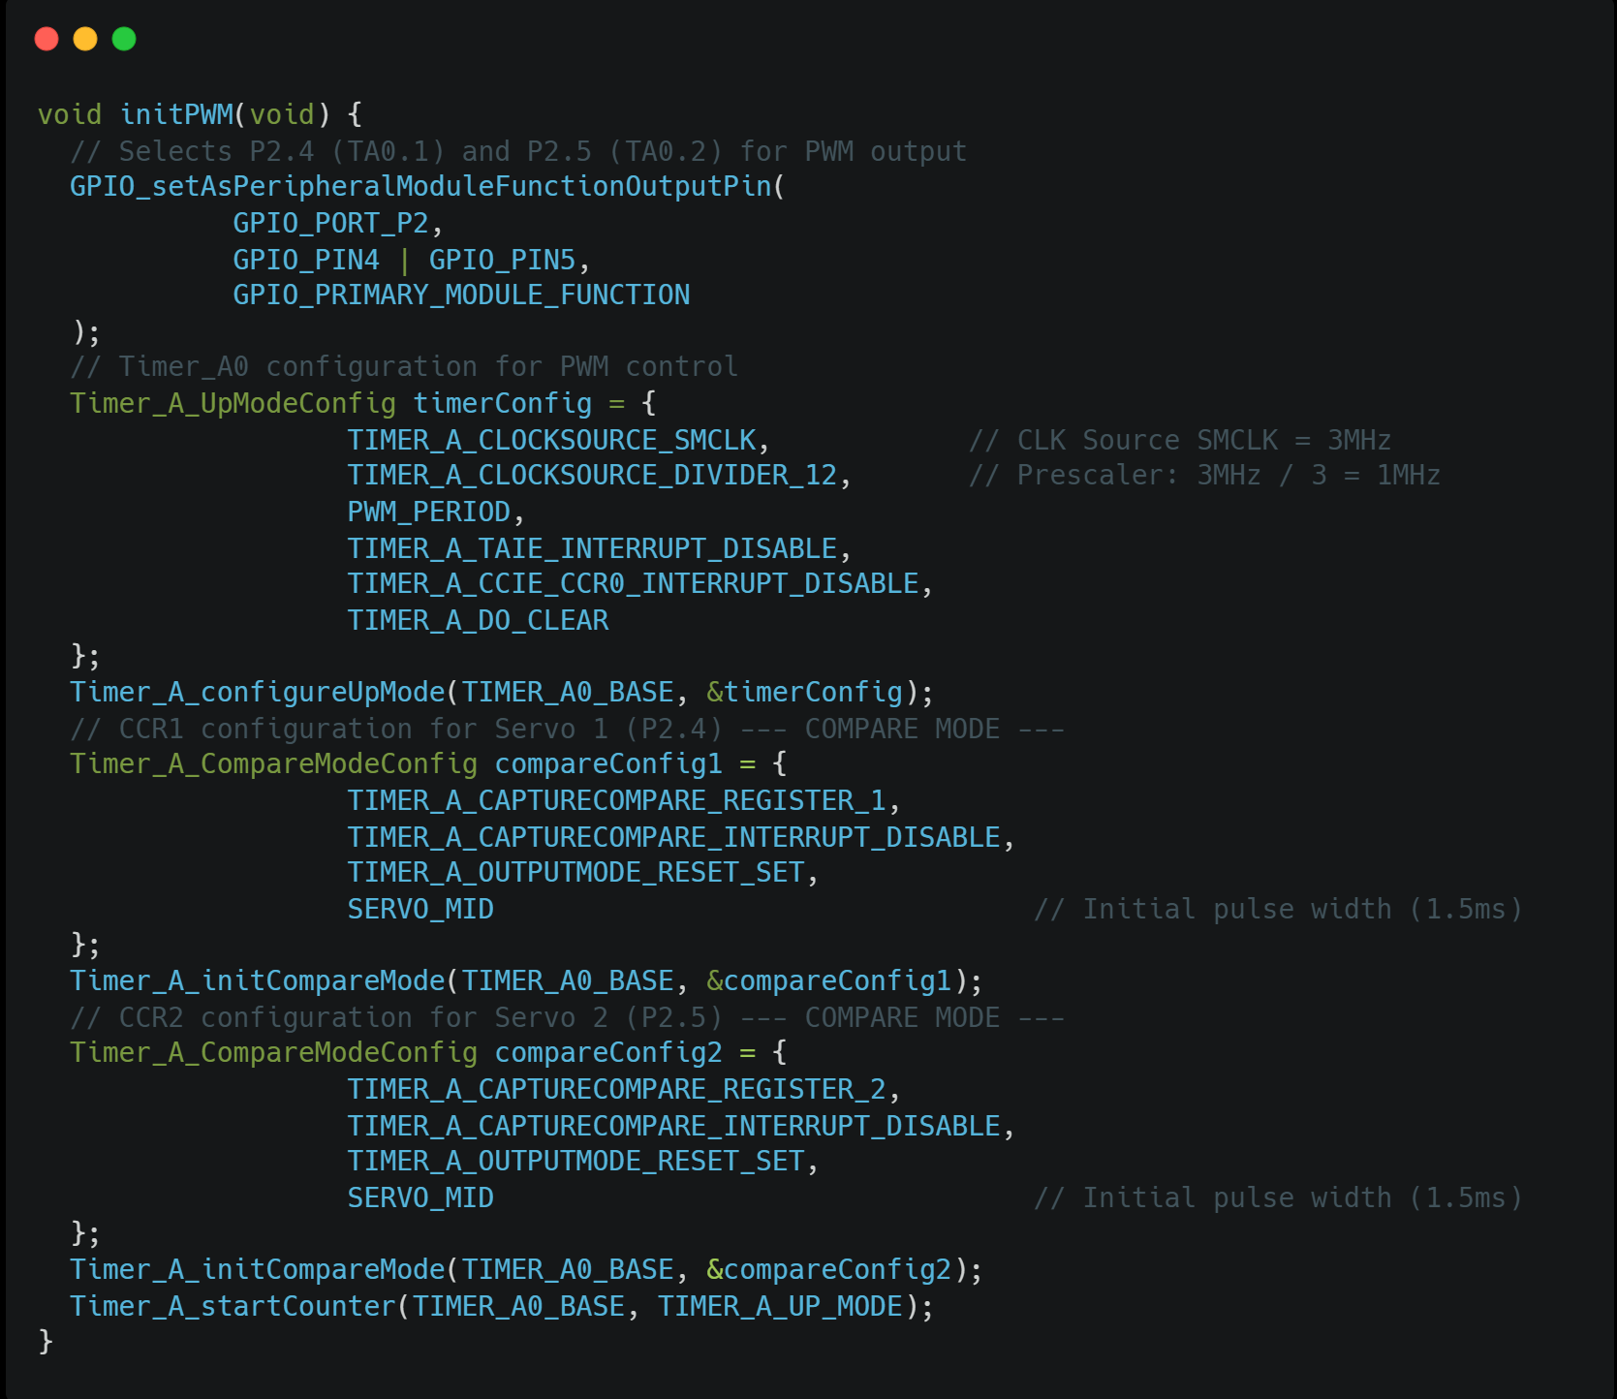
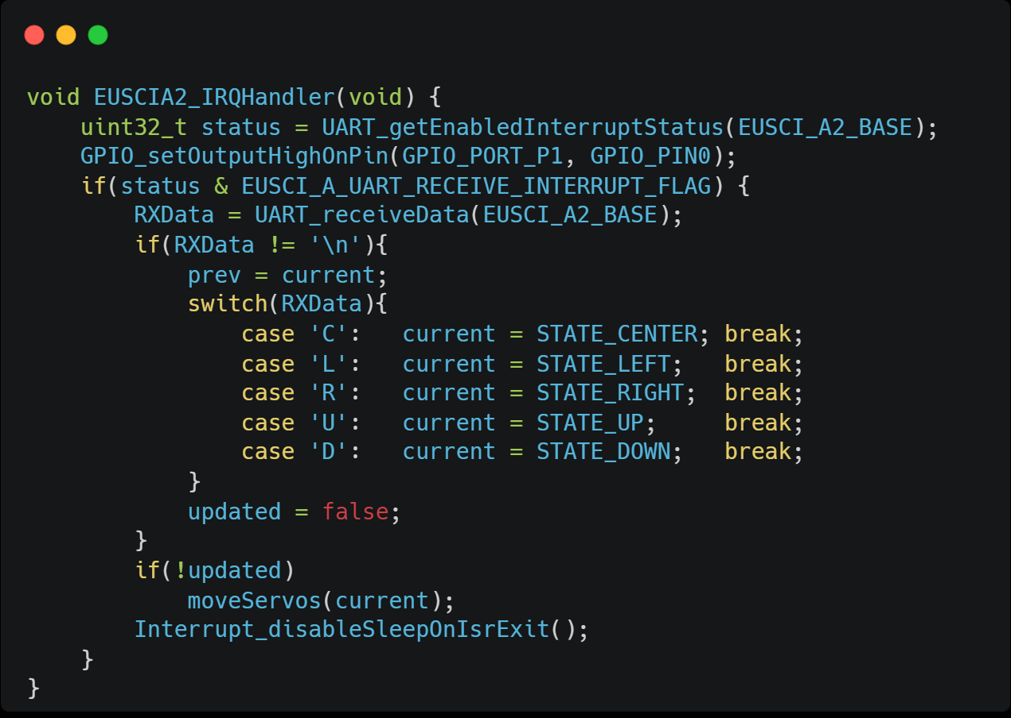
Smart Surveillance: Representative code blocks
PWM TIMER CONFIGURATION
INTERRUPT HANDLER

Slide 5

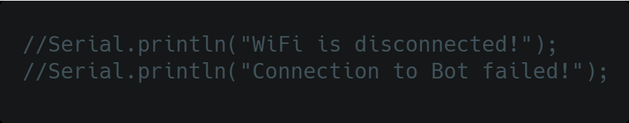

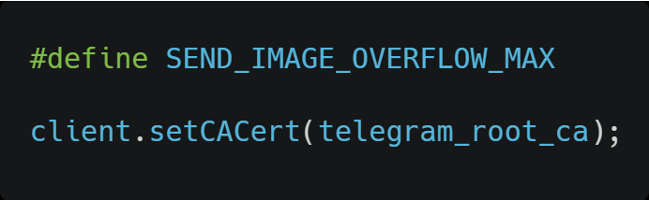
Smart Surveillance: Testing and Debugging
TESTING METHODOLOGY:
Code validation and debugging with serial monitor
~5 minutes test in an open area with sunny conditions with motion at ~2 meters distance
OBSTACLES/CHALLENGES ENCOUNTERED:
Efficient memory allocation → Moved prevFrame from DRAM to PSRAM
Secure HTTP communication and frame spam handling →
Motion localization during movement and UART communication → Added delays and flow controls
Frame computation structure and .JPG conversione → Grayscale instead of Compressed RGB
→ Telegram accepts only .PNG and .JPG

Slide 6

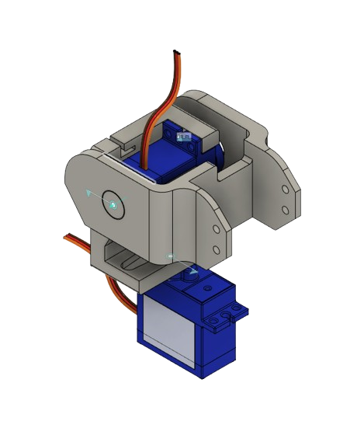

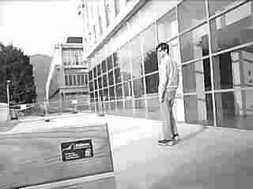
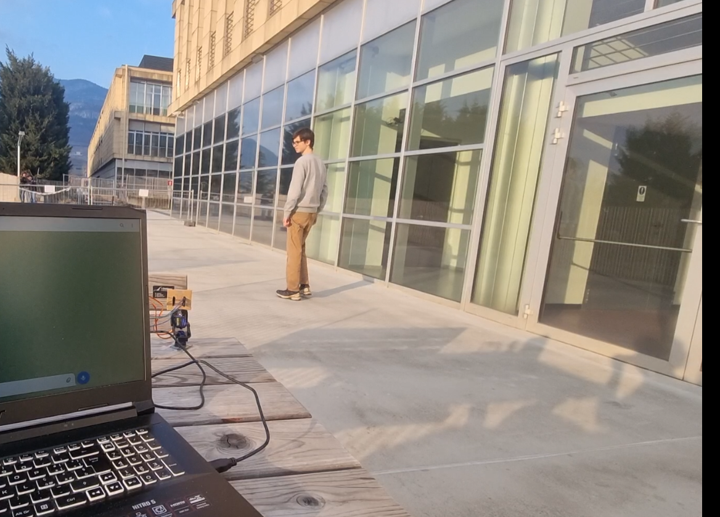

Smart Surveillance: Conclusions and Future Work
UPGRADE PROSPECTS:
Object recognition → Integrate YOLO algorithm for specific functionalities
Light insensitivity → Implement automatic threshold calibration
Dedicated 3D support → Improve detachable mounting for higher stability and accuracy
→ Select quality connectors to avoid noise or interferences
Enhanced user interaction → Add instantaneous full color snapshot command
→ Stream camera feed to dedicated website

Slide 7
Thank you for your kind attention and engagement!
This project was carried out for the course «Embedded Software for the IoT 2024/2025». We sincerely thank Assoc. Prof. K. S. Yildirim for the support and guidance!

